Slide 1
Company Sales Dashboard Analysis
BY Category and Region, 2025

Slide 2
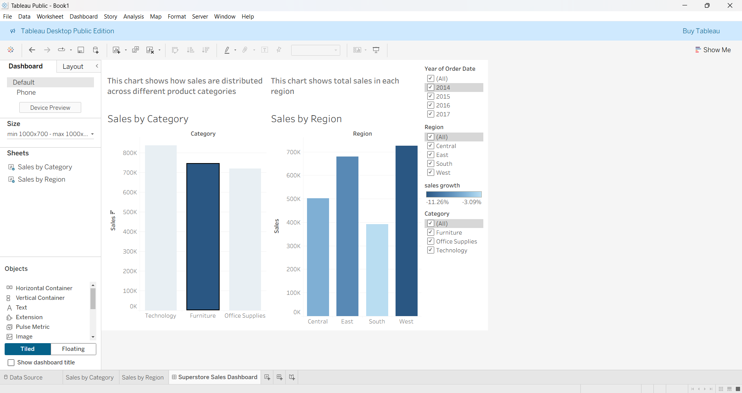
Interactive dashboard showing
sales by category and region

Slide 3
Key Insights
East region has the highest sales
Technology is the top-performing category
Filters allow dynamic exploration of data by category or region

Slide 4
Dashboard Interactivity
Filters for category and region
Tooltips show detailed sales and information on hover
Color coding highlights key metrics and trends

Slide 5
Conclusion :-
This dashboard enables business stakeholders to quickly understand sales performance and make informed decisions.

